Slide 1
Physics in the Nature Park
School grounds as GSCE contexts for evaporation and latent heat

Slide 2
Learning outcomes
Understand that thermal stores of energy increase during a change of state, but temperature remains constant
Observe evaporation in the school grounds and natural environment and link this with the latent heat of vaporisation
Begin to understand how plants and water keep places cooler and protect against heatwaves and climate change

Slide 3

Infra-red scale
Highest surface temperature
Lowest surface temperature​
White indicates the highest surface temperature in a frame and dark blue the lowest.

Slide 4
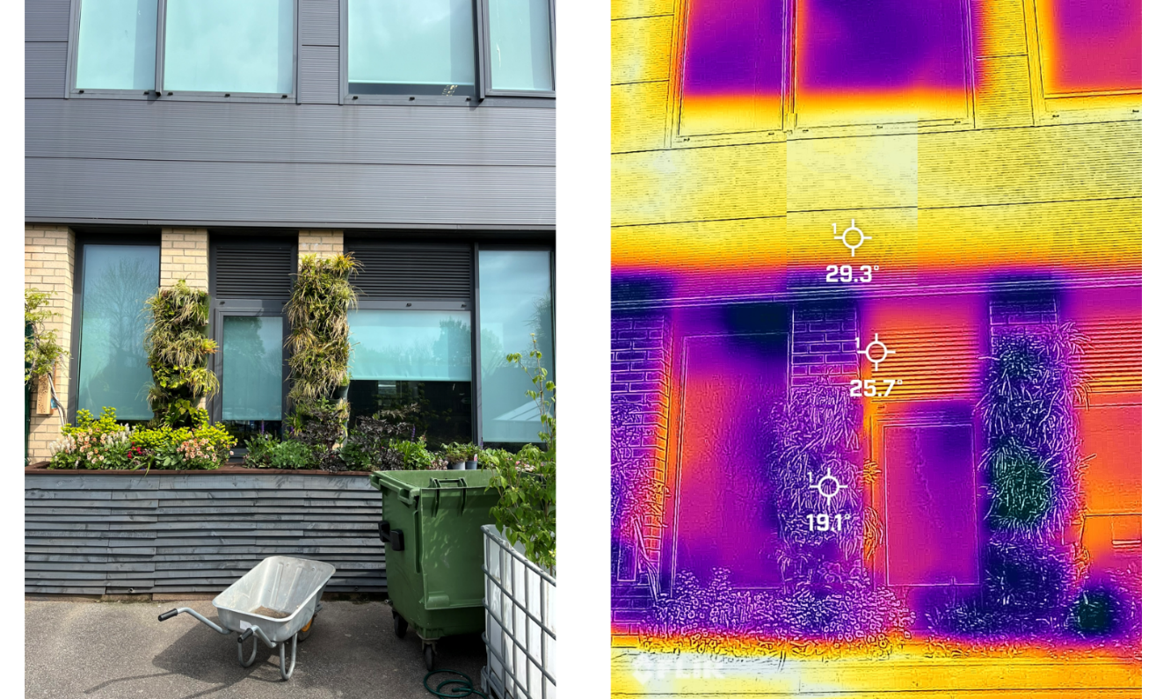
What is the impact of the green wall and the plants on temperature?
What can this do to the temperature in the classroom behind?
Co-op Academy Manchester, May 2024

Slide 5
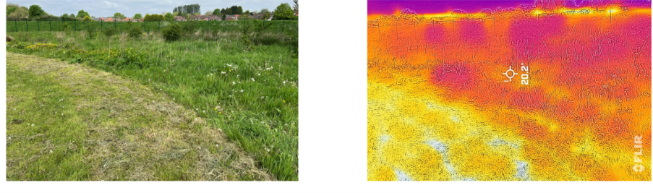
What is the effect of long grass on temperature?
Co-op Academy, Manchester, May 2024

Slide 6
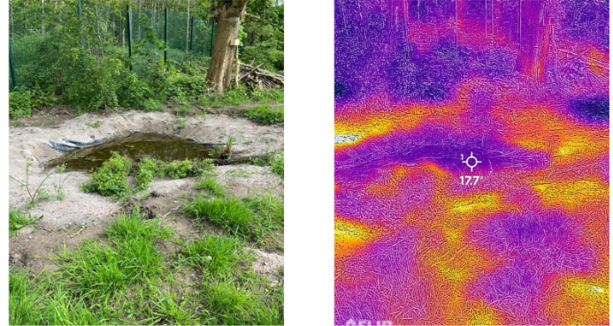
What has been the impact of the trees and of the school pond on temperature?
Co-op Academy Manchester, May 2024

Slide 7
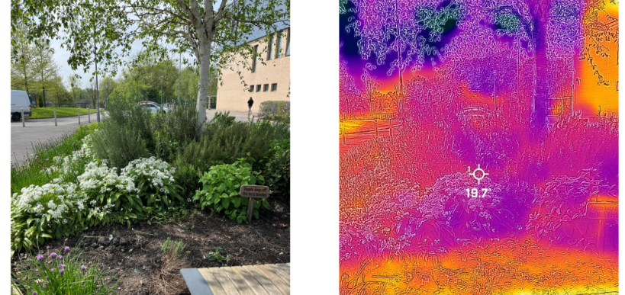
What is the effect of the tall plants here?
Co-op Academy, Manchester, May 2024

Slide 8
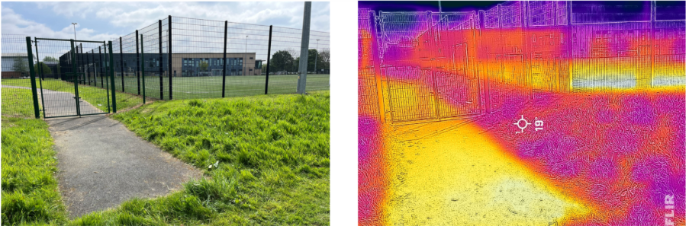
What would the impact be of replacing gardens with paving and artificial grass?
Co-op Academy, Manchester, May 2024

